Slide 1

CNN image classification
Zahra Rezaei Estakhroueiyeh
1959632
Professor Amerini
September 2022
Vision and Perception

Slide 2
Outline:
Dataset
CNN architecture (VGG)
Enhance model
Data pre-processing
Drop-out
Data augmentation
Batch normalization
Regularization
Final model and result
Pre-trained ResNet50

Slide 3
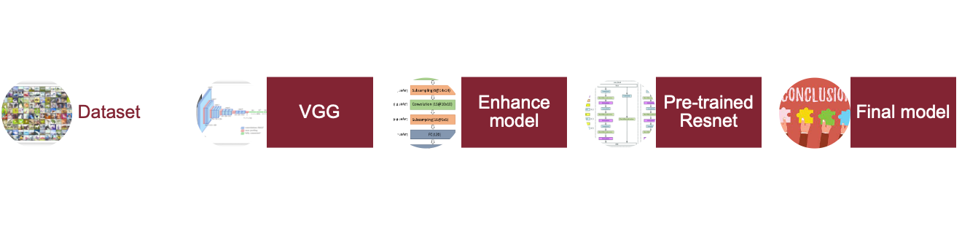
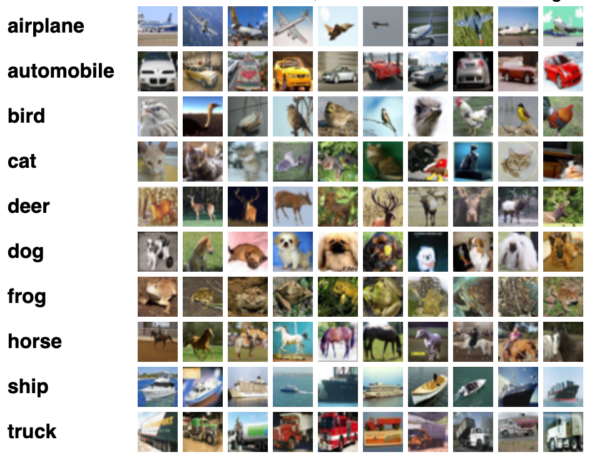
Data set CIFAR-10 dataset:
Consists of 60,000
32x32 colour images
10 classes, 6,000 images
per each class
50,000 training images and
10,000 test images

Slide 4
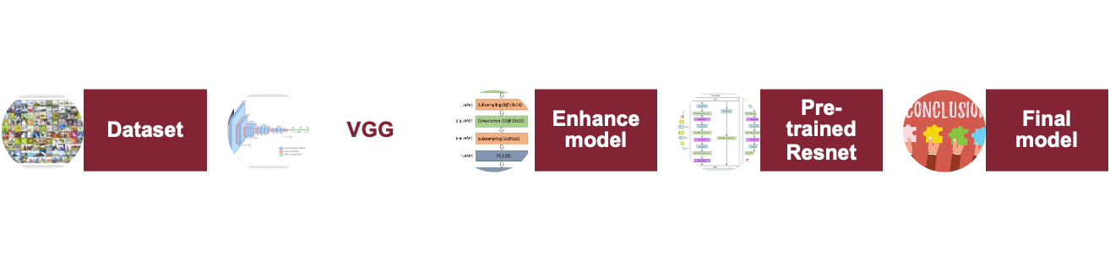
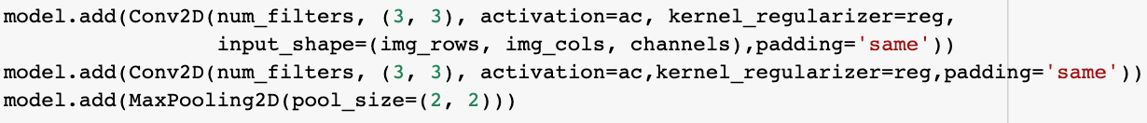
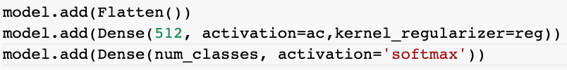
VGG model
Contains some main blocks and a final block
Each block contains:
two Convolutional layer with a
3x3 filter
Same padding
ReLU activation function
Max-pooling to reduce volume size
Final layer:
We need a vector, flatten the previous output
Two fully connected network
A softmax classifier

Slide 5
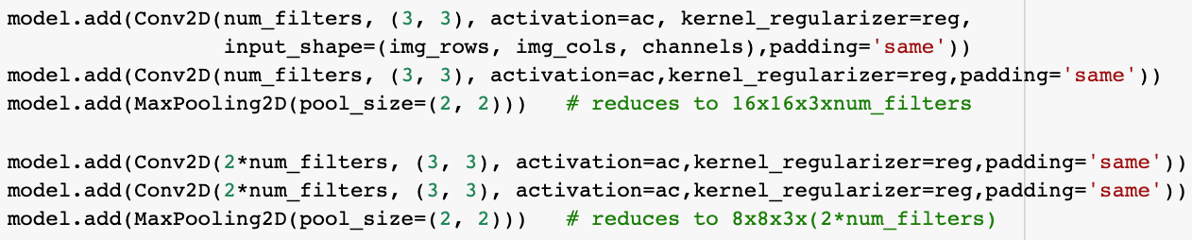
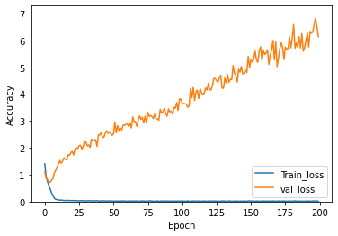
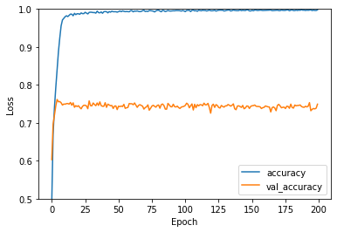
Optimal number of blocks
number of filters in each block become doubled with the depth of the network
such as 32, 64, 128, 256 for the first four blocks of the model.
Two blocks of VGG:
Train: loss: 0.0031 - accuracy: 0.9993
Test: loss: 6.1492 - accuracy: 0.7492

Slide 6
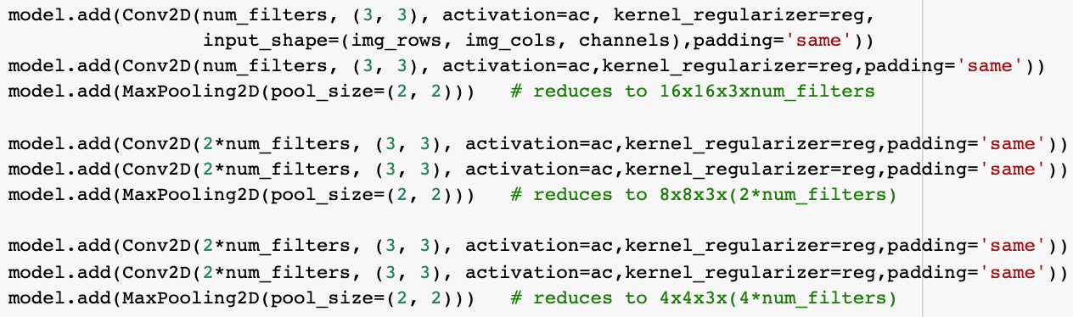
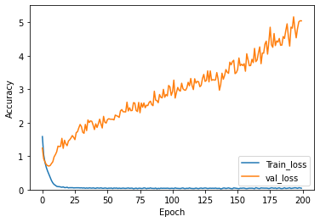
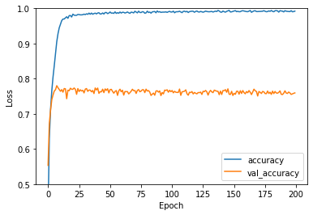
Three blocks of VGG:
Train: loss: 0.0369 - accuracy: 0.9934
Test: loss: 5.0385 - accuracy: 0.7595

Slide 7
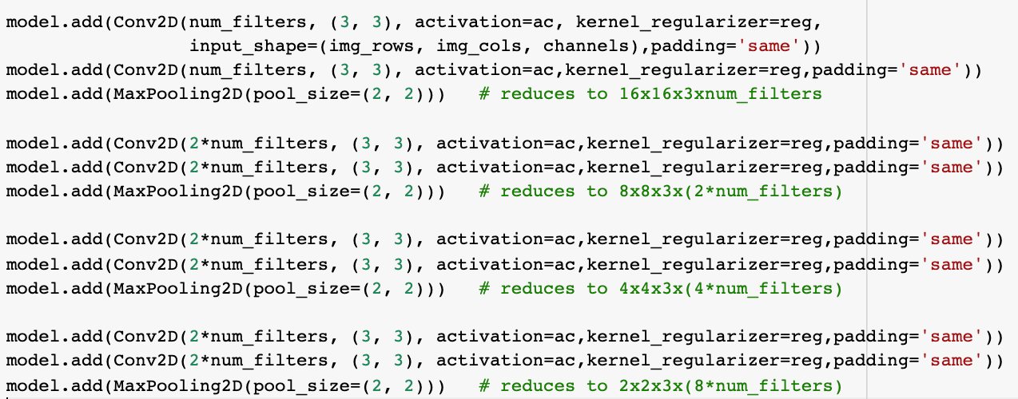
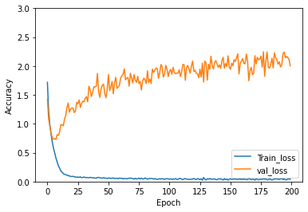
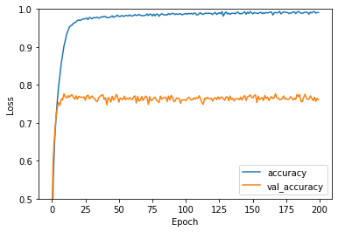
Four blocks of VGG:
Train: loss: 0.0268 - accuracy: 0.9932
Test: loss: 2.0030 - accuracy: 0.7611

Slide 8
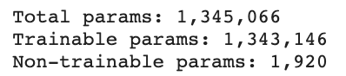
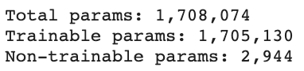
Comparison:
 | Train loss | Test loss | Train acc | Test acc
Two blocks | 0.0031 | 6.1492 | 0.9993 | 0.7492
Three blocks | 0.0369 | 5.0385 | 0.9934 | 0.7595
Four blocks | 0.0268 | 2.0030 | 0.9932 | 0.7611
No much difference between three and four blocks
Trade-off between “time and computation” and “accuracy”

Slide 9
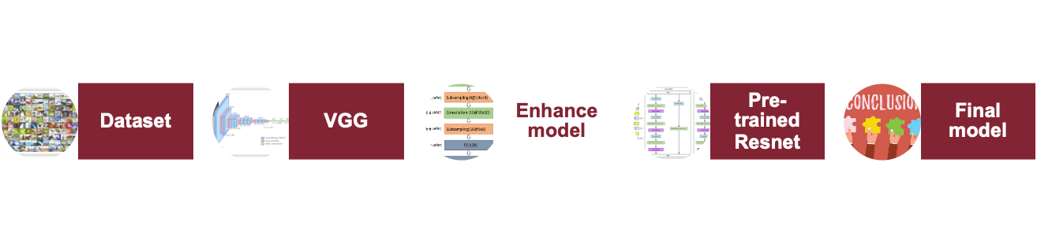
MyModel: Three blocks of VGG:
We have:
Increasing the validation loss after 10 epochs
The gap between validation and train accuracy
Enhance model:
Data pre-processing
Drop-out
Data augmentation
Batch Normalization
Regularization
Parameter Initialization

Slide 10
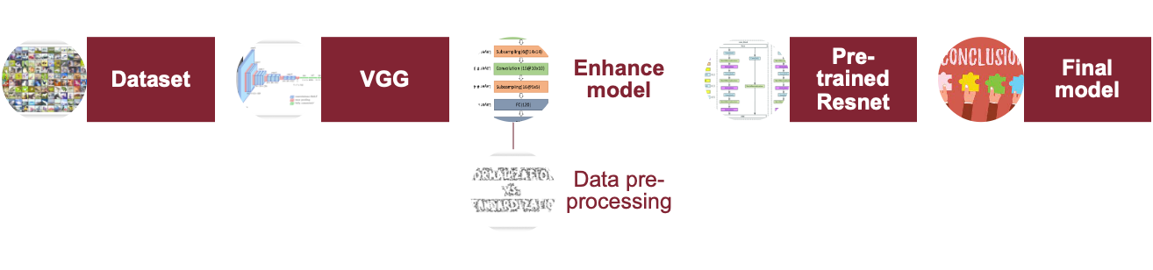
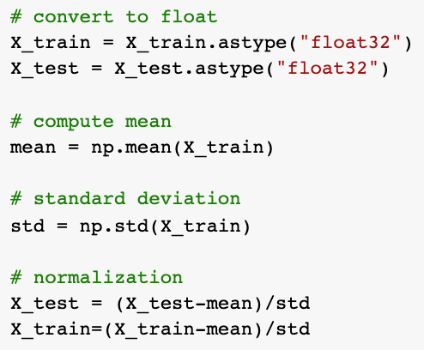
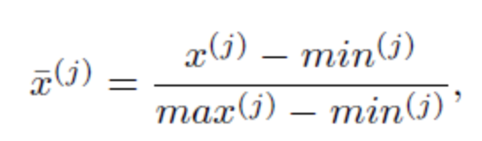
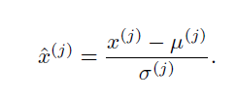
normalization vs Standardization:
Is called feature engineering for raw data
Normalization, converts features into range [0,1]
All of the outputs are in a small range >> Increase
learning speed
Standardization, rescale data into [0,1] with zero mean and standard deviation equal to one

Slide 11
Normalization vs Standardization:
 | Train loss | Test loss | Train acc | Test acc
None | 0.0268 | 2.0030 | 0.9932 | 0.7611
Normalization | 0.0324 | 2.0041 | 0.9912 | 0.7627
Standardization | 0.0534 | 2.6605 | 0.9902 | 0.7760
Standardization had more useful impact

Slide 12
Drop-out
A fully connected layer occupies most of the parameter
neurons develop co-dependency amongst each other
limits the individual power of each neuron
leads to over-fitting of training data.
Dropout reduces interdependent learning among the neurons.
layers co-adapt to correct mistakes from prior layers
makes the model more robust.

Slide 13
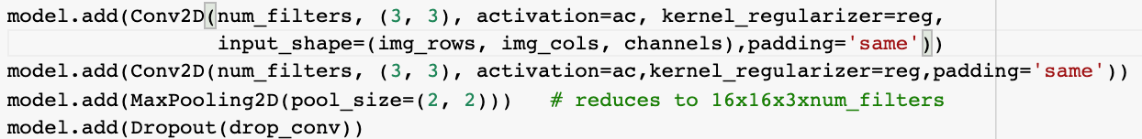
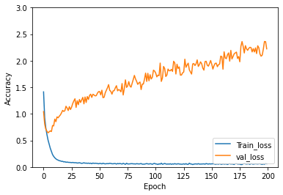
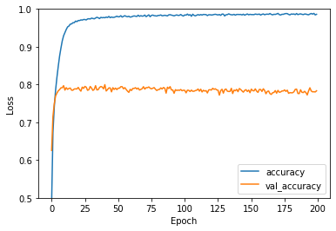
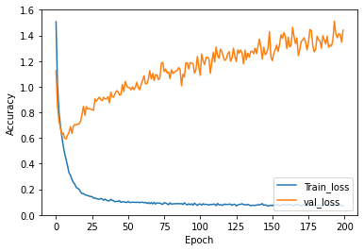
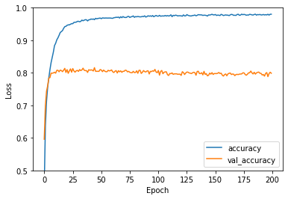
Experiments:
Conv: 0.1, Dense: 0.0
Train: loss: 0.0111 - accuracy: 0.9969
Test: loss: 2.2240 - accuracy: 0.7834
Conv: 0.2, Dense: 0.0
Train: loss: 0.0057 - accuracy: 0.9983
Test: loss: 1.4408 - accuracy: 0.7986

Slide 14
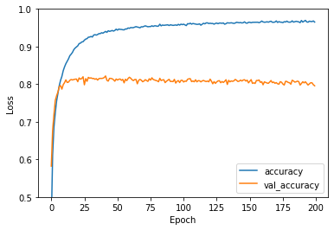
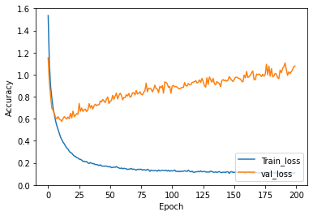
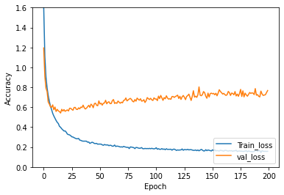
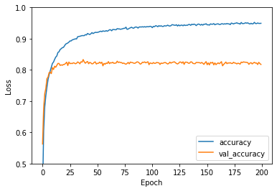
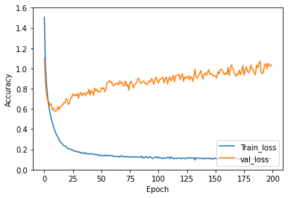
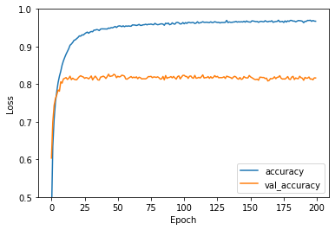
Accuracy:
Conv: 0.3, Dense: 0.0:
Train: loss: 0.0112 - accuracy: 0.9970
Test: loss: 1.0775 - accuracy: 0.7957
Conv: 0.2, Dense: 0.3:
Train: loss: 0.0150 - accuracy: 0.9974
Test: loss: 0.7677 - accuracy: 0.8174
Conv: 0.2, Dense: 0.2:
Train: loss: 0.0068 - accuracy: 0.9981
Test: loss: 1.0359 - accuracy: 0.8165

Slide 15
Comparison:
Cov-Dense | Train loss | Test loss | Train acc | Test acc
0 - 0 | 0.0369 | 5.0385 | 0.9934 | 0.7595
0.1 - 0 | 0.0111 | 2.2240 | 0.9969 | 0.7834
0.2 - 0 | 0.0057 | 1.4408 | 0.9983 | 0.7986
0.3 - 0 | 0.0112 | 1.0775 | 0.9970 | 0.7957
0.2 – 0.2 | 0.0068 | 1.0359 | 0.9981 | 0.8165
0.2 – 0.3 | 0.0150 | 0.7677 | 0.9974 | 0.8174
Conv: 0.2, Dense: 0.3 was selected among all of them.

Slide 16
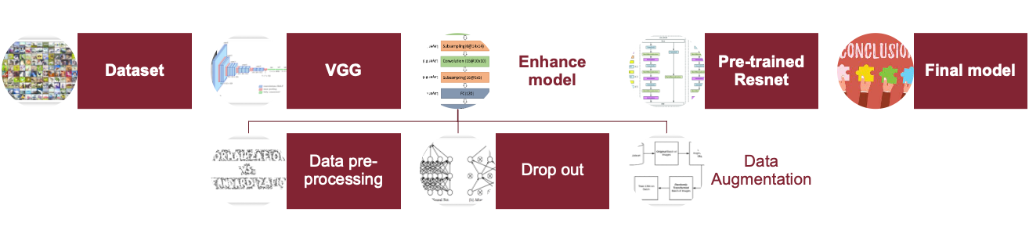
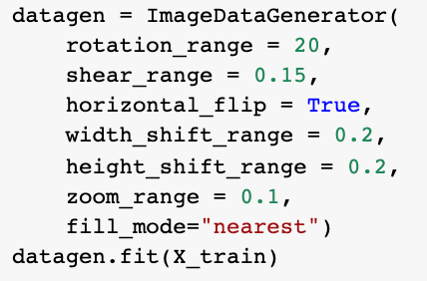
Data augmentation:
Increases the diversity (generalizability) of data without actually collecting new data.
Accepts the original data >> randomly transforms it >> returns only the new, transformed data (not both of them).
Step 1: Present an input batch of images
to the ImageDataGenerator
Step 2: Transforms each image
Step 3: return the randomly transformed batch to the calling function.

Slide 17
Data augmentation:
Increases the diversity (generalizability) of data without actually collecting new data.
Accepts the original data >> randomly transforms it >> returns only the new, transformed data (not both of them).
Step 1: Present an input batch of images to the
ImageDataGenerator
Step 2: Transforms each image
Step 3: return the randomly transformed batch
to the calling function.

Slide 18
Comparison:
 | Train loss | Test loss | Train acc | Test acc
No DA | 0.0150 | 0.76777 | 0.9974 | 0.8174
DA | 0.0113 | 0.7653 | 0.9981 | 0.8262
Data Augmentation increases the accuracy

Slide 19
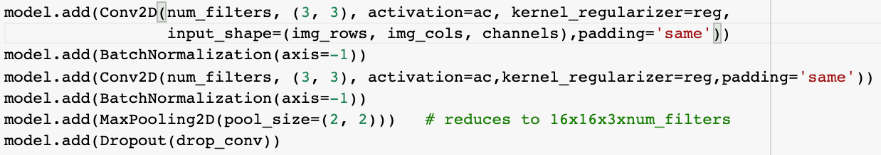
Batch Normalization:
Standardize the output of each layer >> increase the stability
there’s no activation that’s gone too high or too low >> use higher learning rates
has a slight regularization effects >> Reduces over fitting
Similar to dropout, it adds some noise to each hidden layer’s activation >> use smaller value for dropout >> not losing a lot of information.

Slide 20
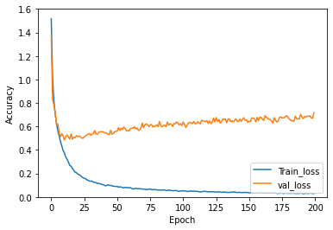
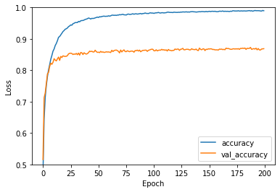
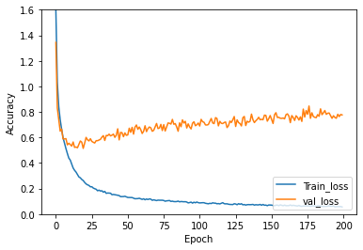
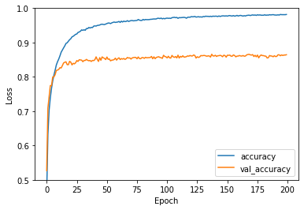
Experiments:
Before VGG, batch normalization didn’t exist >> it’s not in its block >> we add it
Some papers believe it is better to use it after activation function, and some other says better to use before activation function
After activation:
Train: loss: 1.1685e-04 - accuracy: 1.0
Test: loss: 0.7161 - accuracy: 0.8687
Before activation:
Train: loss: 3.4117e-04 - accuracy: 1.00
Test: loss: 0.7764 - accuracy: 0.8644
:

Slide 21
Batch Normalization:
 | Train loss | Test loss | Train acc | Test acc
No BN | 0.0113 | 0.7653 | 0.9981 | 0.8262
Before activation | 3.4117e- 04 | 0.7764 | 1.0000 | 0.8644
After activation | 1.1685e- 04 | 0.7161 | 1.0000 | 0.8687
Applying BN after activation function, worked better

Slide 22
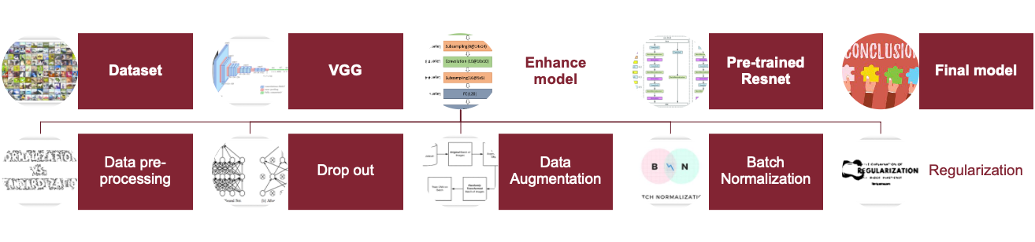
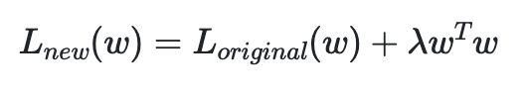
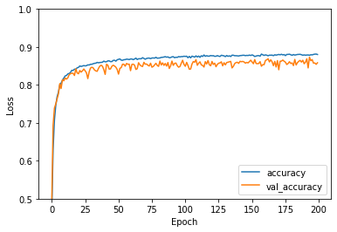
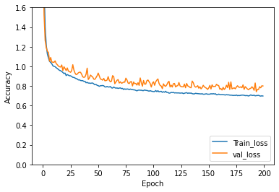
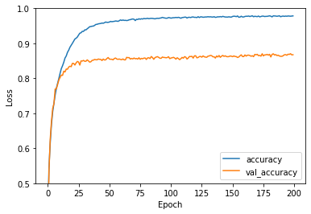
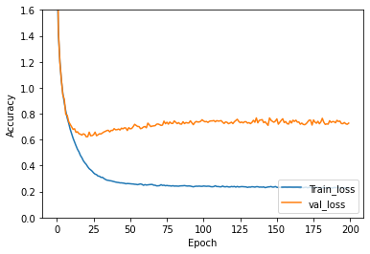
Regularization:
Weight decay or L2, Penalizes complexity of the model to prevent over fitting
Reg= l2(1e-3), lr= 0.001
Train: loss: 0.5811 - accuracy: 0.9212
Test: loss: 0.7998 - accuracy: 0.8583
Reg= l2(1e-4), lr= 0.0003
Train: loss: 0.1668 - accuracy: 0.9997
Test: loss: 0.7274 - accuracy: 0.8674

Slide 23
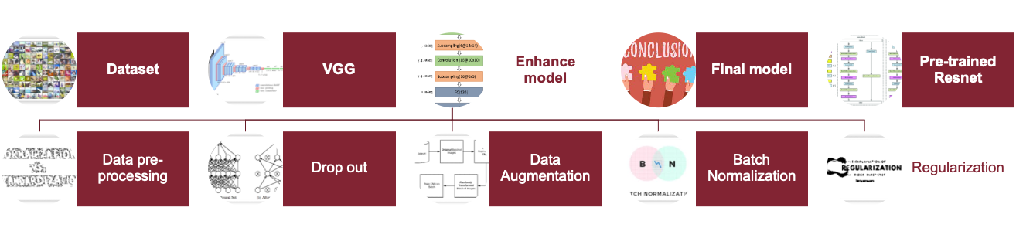
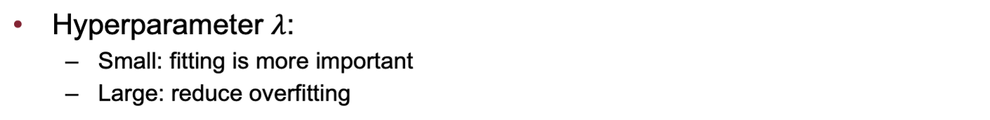
Comparison:
 | Train loss | Test loss | Train acc | Test acc
No Reg | 1.1685e-04 | 0.7161 | 1.0000 | 0.8687
Reg= 12(1e-4) Ir= 0.0003 | 0.1668 | 0.7274 | 0.9997 | 0.8674
Reg= 12(1e-3) Ir=0.001 | 0.5811 | 0.7998 | 0.9212 | 0.8583

Slide 24
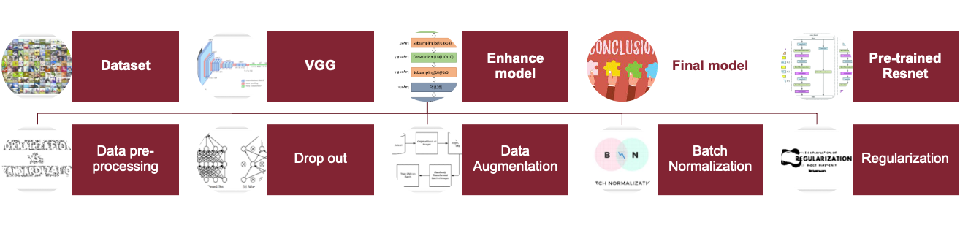
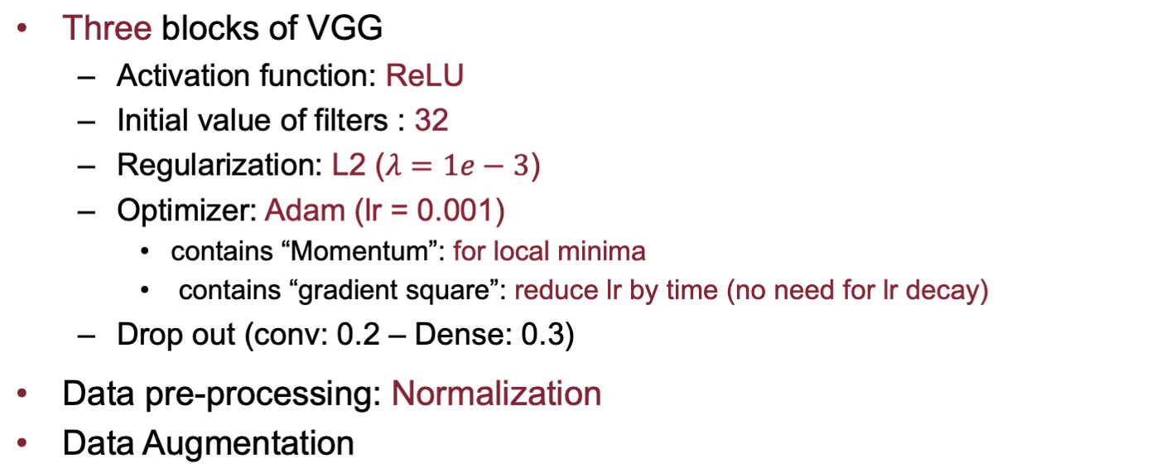
Final Model:

Slide 25
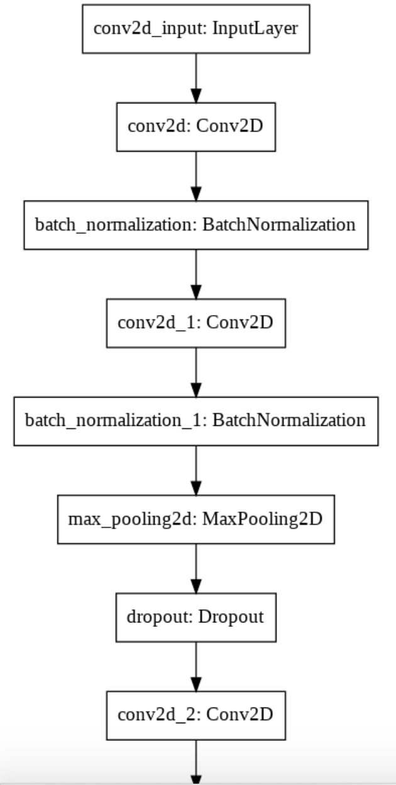


Comparison:

Slide 26

Properties:

Slide 27



Results:
Final result with 3 blocks:
Train: loss: 0.1591 - accuracy: 0.9999
Test: loss: 0.7198 - accuracy: 0.8793
Gap between train-validation set
Increase Drop-out, Regularization
Weight initialization (Xavier)
Normal distribution of mean=0 , std = sqrt(2/(fan_in+fan_out))
Saturation after 100 epochs
Use callback()

Slide 28


Final result:
Final result with 3 blocks:
Train: loss: 0.3672 - accuracy: 0.9413
Test: loss: 0.5368 - accuracy: 0.8915

Slide 29


ResNet:
Vanishing gradient: the deeper network >> the smaller gradient >> saturation or even decrement in performance
>> apply “Skip connection”: the performance won’t decrease

Slide 30


ResNet 50:
Contains 5 stages
Layers of each conv block had the same #filters for same size of output
Double number of filters in each block
Identitiy blocks must have the same size as well
Stride 2

Slide 31


Slide 32



Transfer learning:
Use a pre-trained weights and just adjust the final layers:

Slide 33


Result:
Train: loss: 0.0613 - acc: 0.9820
Test: val_loss: 1.4761 - val_acc: 0.7738

Slide 34
Thanks for your attention

